Slide 1
CubiKit slides
Teacher Guide

Slide 2
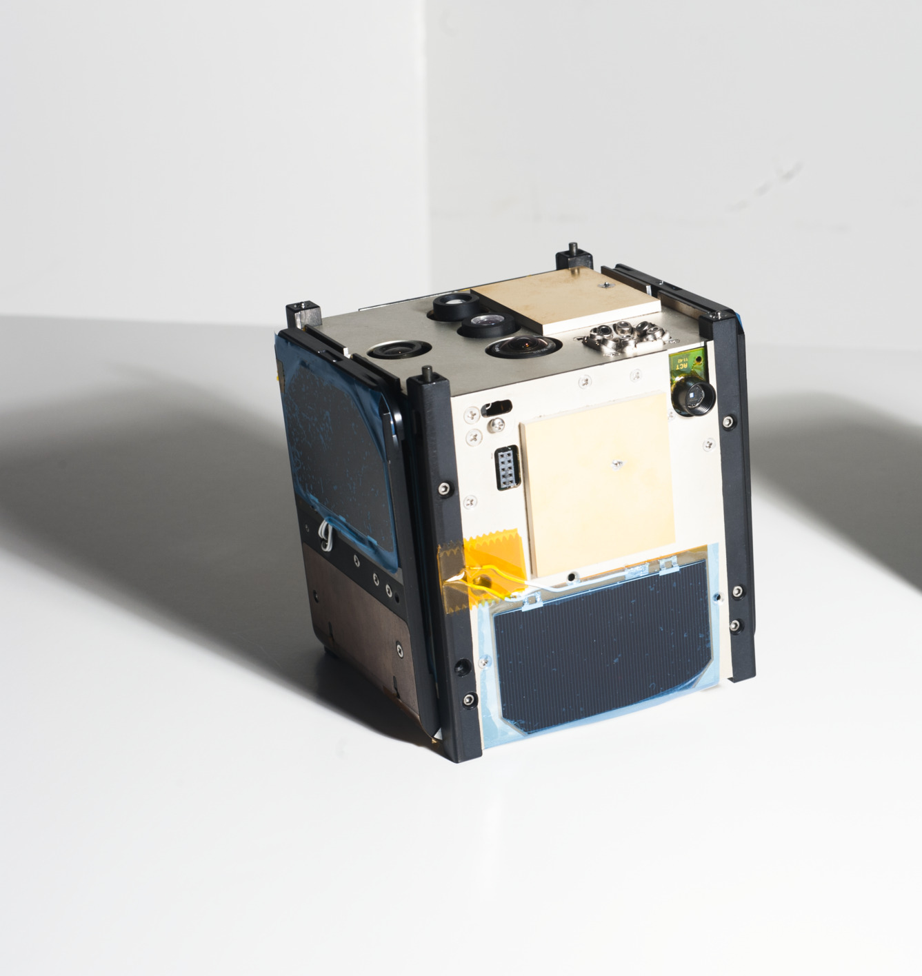
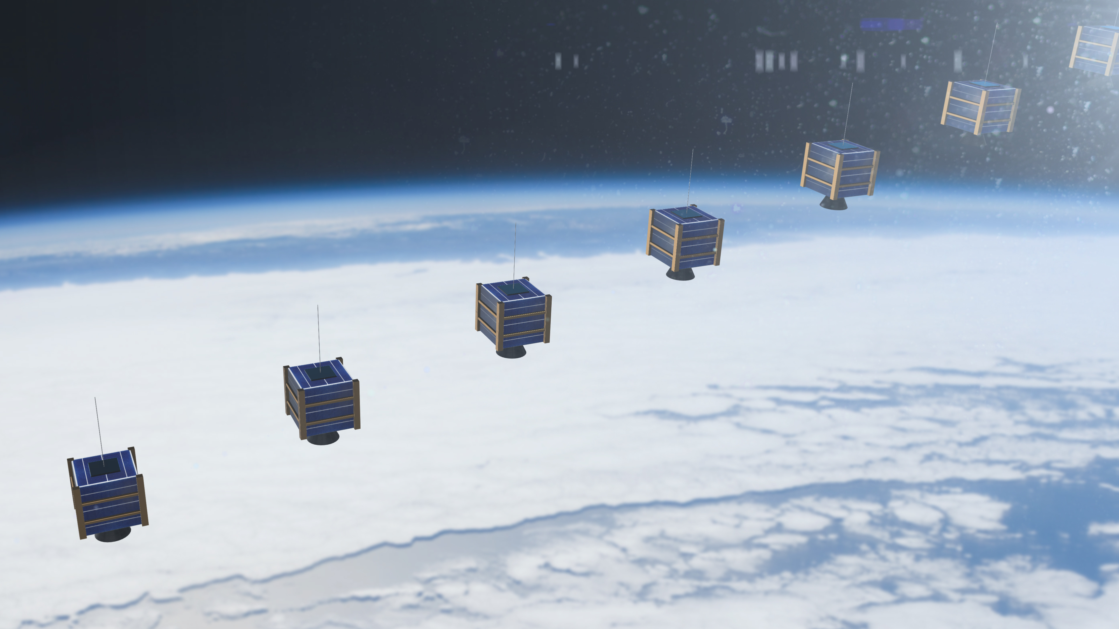
Cubesats
Cubesats are compact satellites that allows data collection from orbit in a small form factor of 10 cm³. This small form factor allows for many more cubesats to be launched into space compared to satellites of traditional sizes.
Since weight has a large impact on the cost of going to space, Cubesats allow for increased missions because many can do what much larger satellites were designed to do in the past.
Notes:
Missing Sources

Slide 3
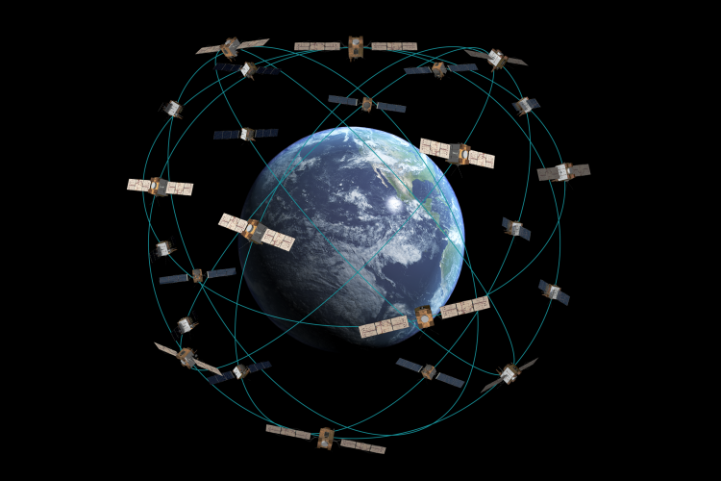
Cubesats
Cubesats are compact satellites that allow constellations to be made around the Earth in order to monitor various events.
Due to their small size, many cubesats can occupy low Earth orbit (LEO)
Despite their benefits, Cubesats still need to be controlled from the ground and complications may still arise. This is one of the purposes of this Cubi kit, to understand how to orient and control a Cubesat.
Notes:
Adobe Stock – used on our website here https://aerospace.org/article/constellation-reconfiguration

Slide 4
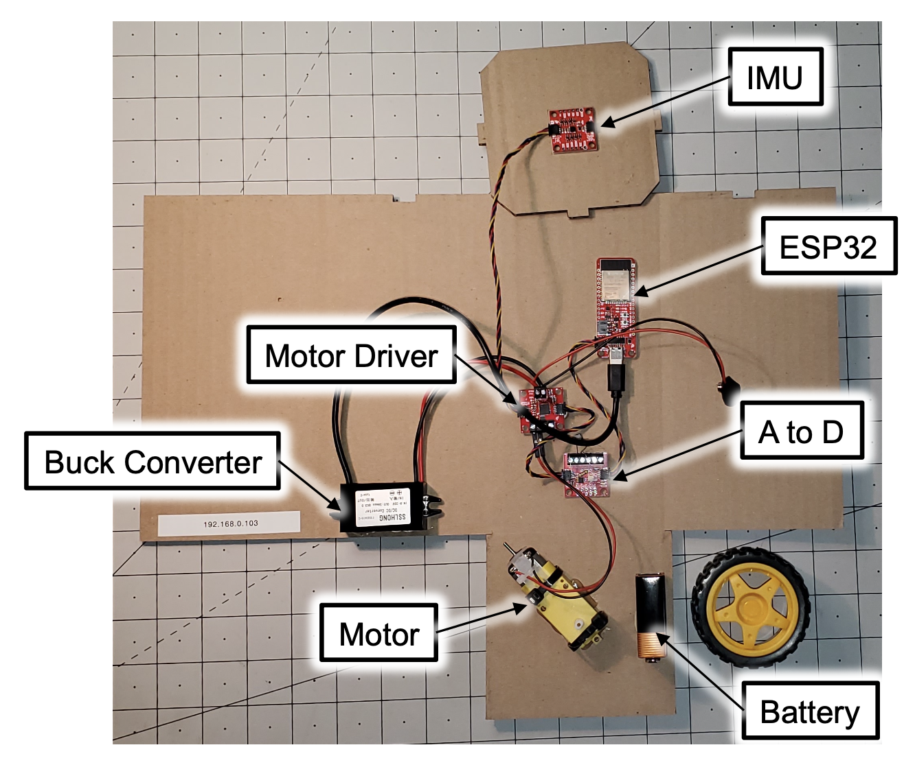
STEM Kit (Identify items and Definitions)
Inertial Measurement Unit (IMU) –
Motor Driver –
Buck Converter –
Motor –
A to D –
ESP32 –
Notes:
Our own Photo

Slide 5
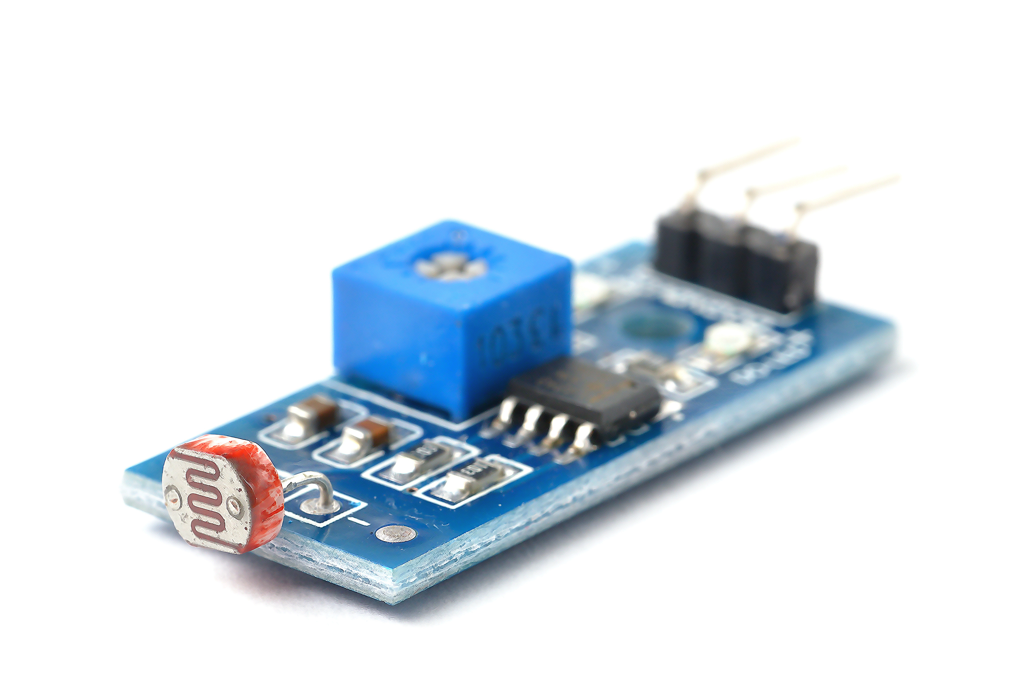
Photocell (Sun Sensor)
The photocell is what is referred to as the Sun Sensor. This simulates the real sun sensors that Cubesats use to orient themselves when in orbit.
Note: The photocell in the Cubi kit is the only light sensing device. The code simulates solar array readings.
Notes:
Photo from item on web

Slide 6
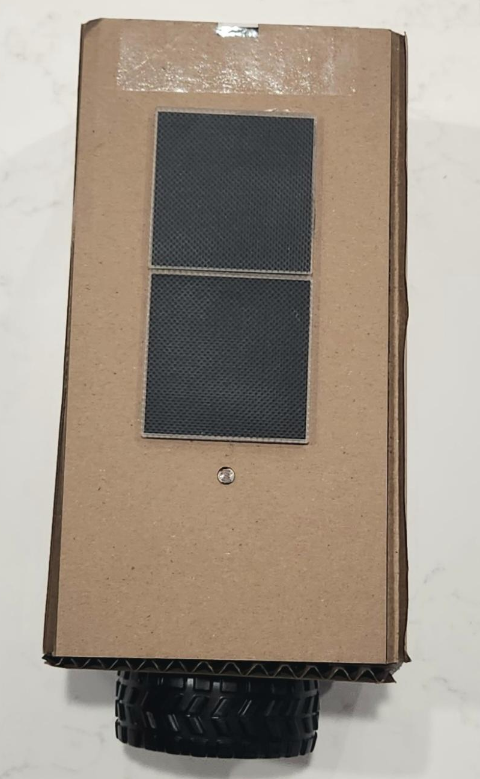
Solar Panel
The solar panel absorbs a particular spectrum of light and converts it to electrical energy to be used in the circuit. In the data link page (once the computer is connected to the Cubi wifi), you will see the power output measured in Watts (W).
Note: Currently the CubiKit does not use the solar panel in its current configuration, but the photosensor is similar to the solar panel data for the purposes of the lesson.

Slide 7
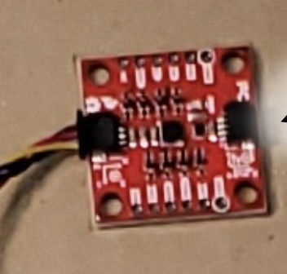
Inertial Measurement Unit (IMU)
Devices
Accelerometer
  Measures the acceleration the Cubi is experiencing in the x, y, and z directions. Units are in milligrams (mg)
Gyrometer
  Measures the amount of rotation the Cubi is experiencing about the x, y, and z axes. Units are in degrees per second (deg/sec)
Magnetometer
  Measures the relative amount of magnetic field in the local area around the IMU on the Cubi. Units are in microteslas (𝜇T)
Notes:
Own image

Slide 8
CubiKit Control, Notes for the Instructor:
The following commands put the Cubikit into different modes throughout the lesson. The student designated as the ‘Commander’ should be the only one changing the mode of the satellite. Note that the final mode should not be shared with the students until they have provided the correct solution to the challenge.

Slide 9
CubiKit Controls for Instructor
Once STEMkit is built, power on the STEMkit and join the WIFI hot spot being broadcast by your STEMkit (the name will be STEMkit_xxxx where xxxx is the last four characters of the MAC address)
Using your browser, open STEMkit Mission Data Downlink: http://192.168.4.1/
In another tab, mission commander open STEMkit Mission Control: http://192.168.4.1/missioncontrol
STEMkit starts off in safe mode
  Students can discover the sensors and what they detect
Mission Commander place the STEMkit in normal mode: http://192.168.4.1/set?mode=normal
  STEMkit will now work as normal and try to track the sun
Mission Commander place STEMkit in simulated error mode: http://192.168.4.1/set?mode=sim_error
  Students will notice that STEMkit is rotating erratically and not tracking the sun anymore
  Let them figure out what is going wrong, what sensor is causing the error
Mission Commander place STEMkit in solar panel tracking mode: http://192.168.4.1/set?mode=sp_tracking
  Ignore the faulty sensor and track the sun again This should be withheld from students until the team or individual demonstrates the correct solution to the problem.

Slide 10
Tips on Lesson
Lighting in the room may have a negative impact to the proper functioning of the solar sensor and solar panels. Testing these values at various points in the room is recommended before lesson.
Students will likely discover they can connect to other groups’ Cubi through the wifi signal produced by that kit. While a fix is being developed, the best mitigation practice is to have each group connect to their kit one at a time and monitoring the groups thereafter.
If a CubiKit stops sending live data, it may be the battery is dead inside the Cubi. In worse cases, it may be the construction (e.g. wiring) that forces the kit to stop working properly. A telltale sign of a power problem is the kit will stop producing a wifi signal and a blue light is intermittent on the motor driver board.

Slide 11
Standards Alignment (NGSS)
HS-PS2-1. Analyze data to support the claim that Newton’s second law of motion describes the mathematical relationship among the net force on a macroscopic object, its mass, and its acceleration.
HS-PS2-5. Plan and conduct an investigation to provide evidence that an electric current can produce a magnetic field and that a changing magnetic field can produce an electric current.
HS-PS4-2. Evaluate questions about the advantages of using a digital transmission and storage of information.
HS-PS4-5. Communicate technical information about how some technological devices use the principles of wave behavior and wave interactions with matter to transmit and capture information and energy.
HS-ESS1-4. Use mathematical or computational representations to predict the motion of orbiting objects in the solar system.
HS-ESS3-5. Analyze geoscience data and the results from global climate models to make an evidence-based forecast of the current rate of global or regional climate change and associated future impacts to Earth systems.
HS-ETS1-2. Design a solution to a complex real-world problem by breaking it down into smaller, more manageable problems that can be solved through engineering.

Slide 12
Standards Alignment (CTE)
B1.0 Communicate and interpret information clearly in industry-standard visual and written formats.
B1.5 Create reports and data sheets for writing specifications
B6.0 Employ the design process to solve analysis and design problems.
B6.1 Understand the steps in the design process.
B6.2 Determine what information and principles are relevant to a problem and its analysis.
B6.3 Choose between alternate solutions in solving a problem and be able to justify the choices made in determining a solution.
B6.5 Demonstrate the process of developing multiple details, within design constraints, into a single solution.
B6.6 Construct a prototype from plans and test it.
B6.7 Evaluate and redesign a prototype on the basis of collected test data.
B8.0 Understand fundamental control system design and develop systems that complete pre programmed tasks.
B8.1 Identify the elements and processes necessary to develop a controlled system that performs a task.
B8.2 Demonstrate the use of sensors for data collection and process correction in controlled systems.
B8.3 Perform tests, collect data, analyze relationships, and display data in a simulated or modeled system using appropriate tools and technology.
B8.4 Program a computing device to control systems or processes.
B8.6 Assemble input, processing, and output devices to create controlled systems capable of accurately completing a preprogrammed task

