Slide 1
Near-Earth Object
Teacher Slides
Speaker’s Name and Organization –
20 Point Arial
October 2020

Slide 2
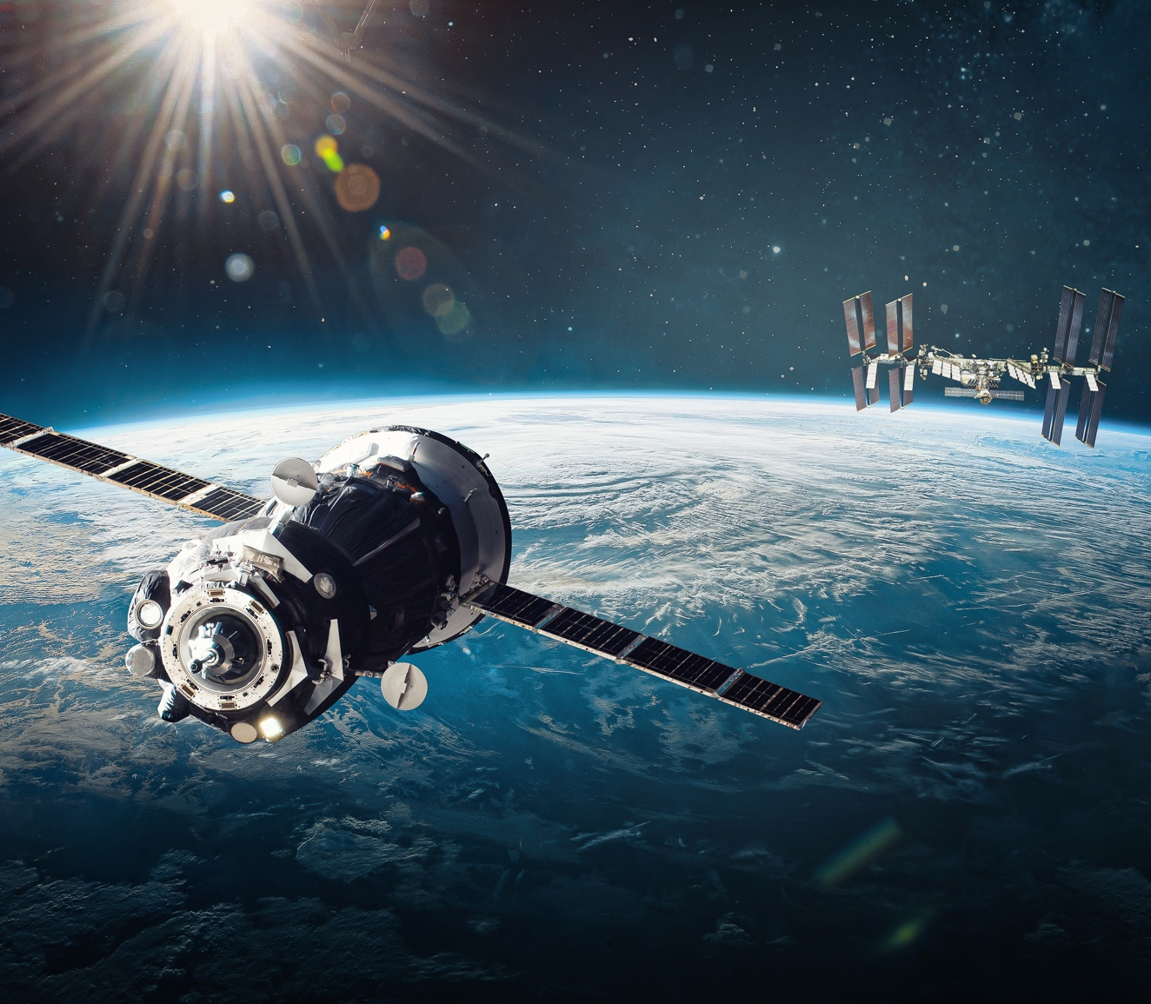
Section A – Thinking About Space
When do you think were you first curious about space? Explain in detail as much as you remember.
How often do you think space connects/ interacts with Earth? Explain in detail.
How do you think space can specifically affect your life today? Explain your thinking.

Slide 3
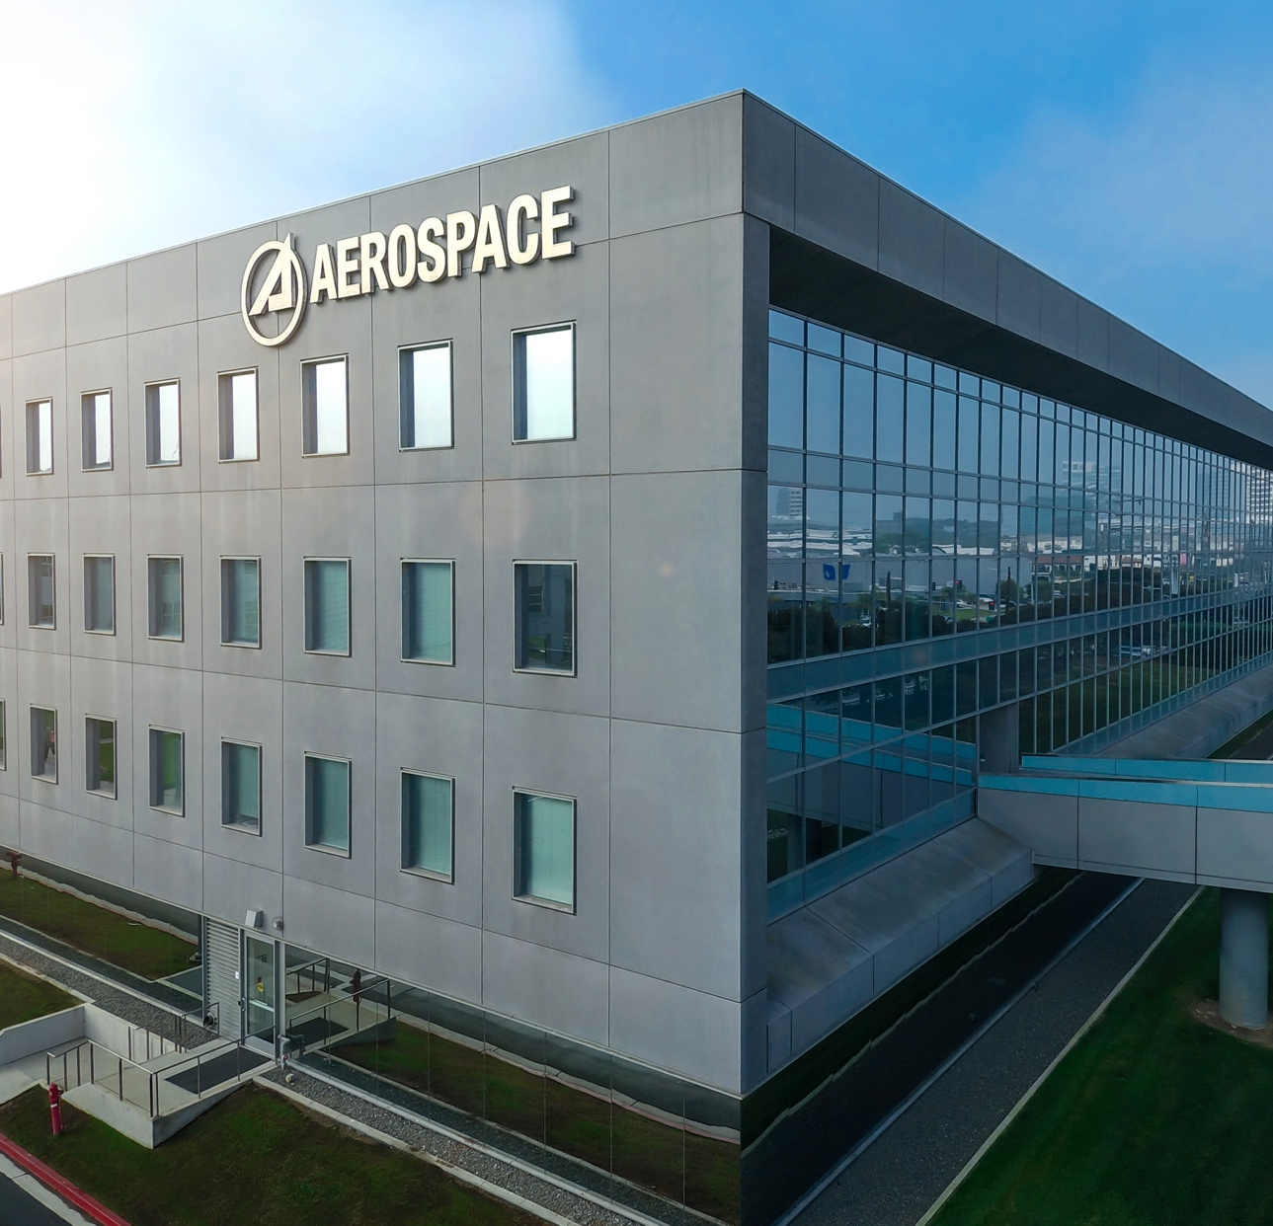
Section B – The Aerospace Corporation
What do you notice or observe about
The Aerospace Corporation message?

Slide 4
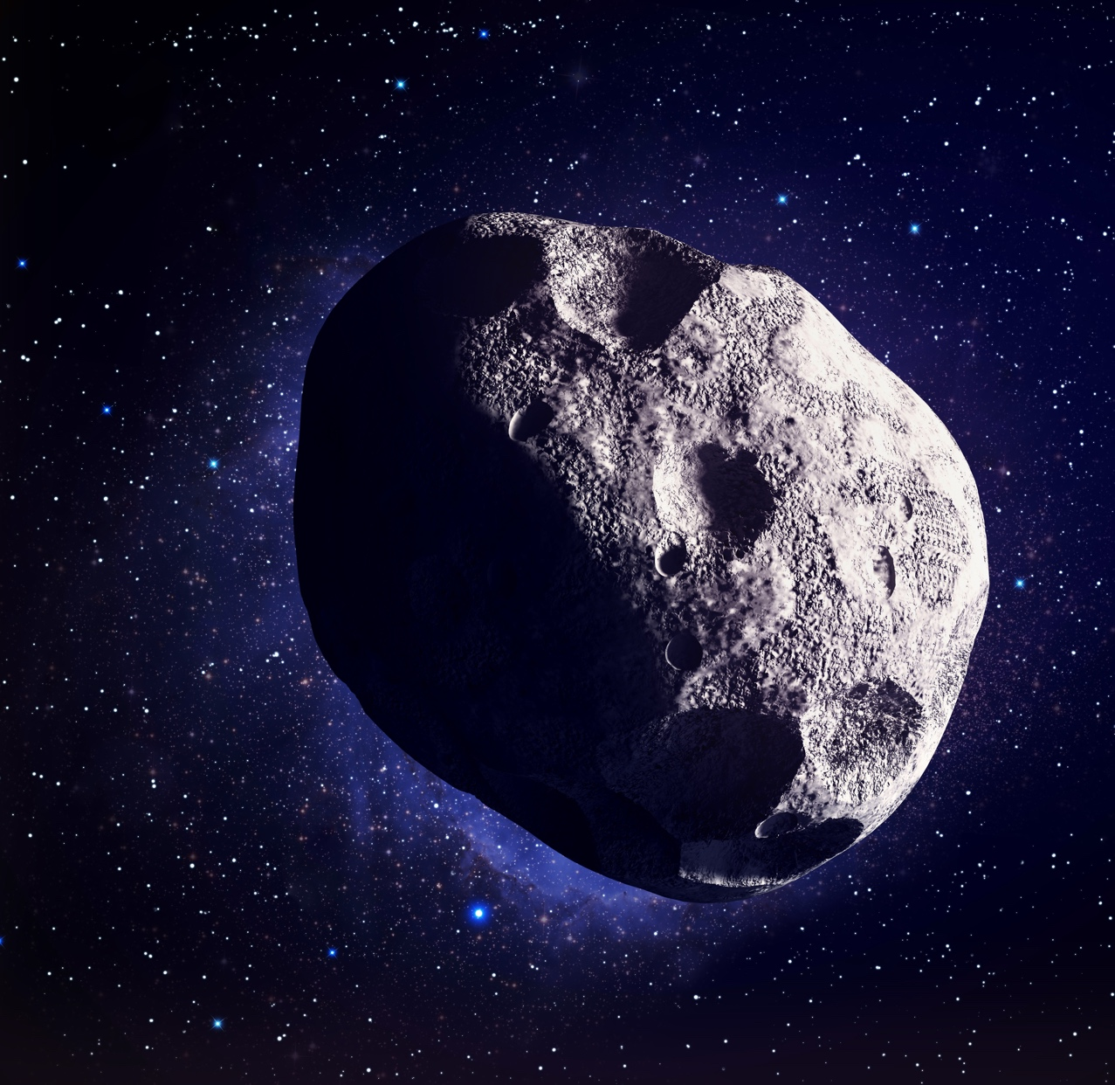
Section C – Citizen Science Application
What did you learn about identifying asteroids?
How might citizen science be useful in other research projects?
How does this connect to our idea of science being discovered daily and that everyone can be a scientist?

Slide 5
Section D – Vocabulary Development

Slide 6
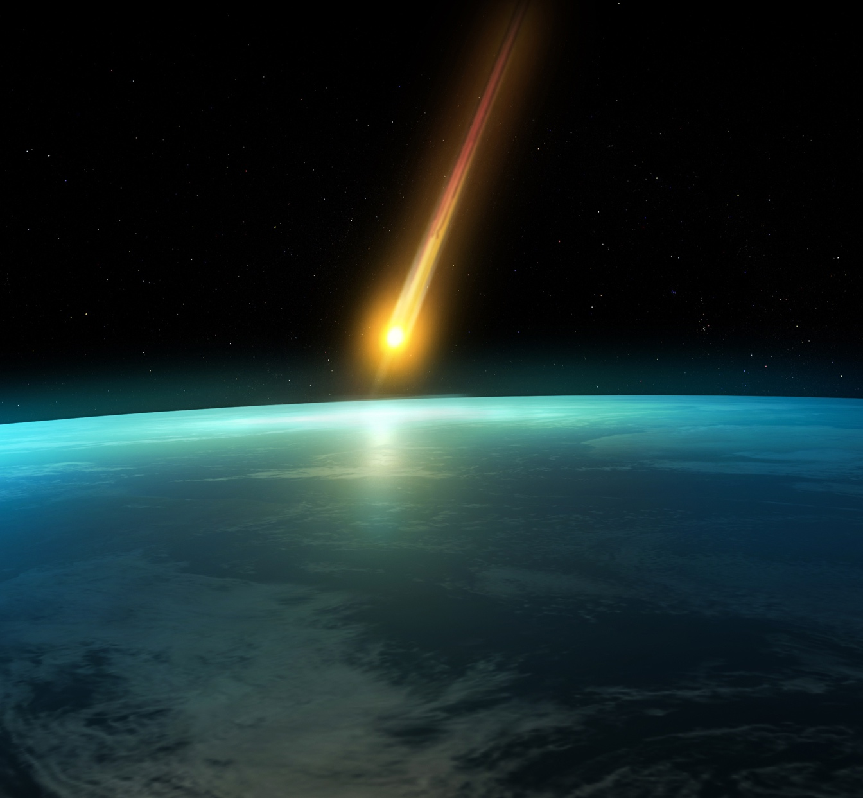
Section E – Near-Earth Objects
What do you think a near-Earth object is?
What do you think a fireball is?

Slide 7
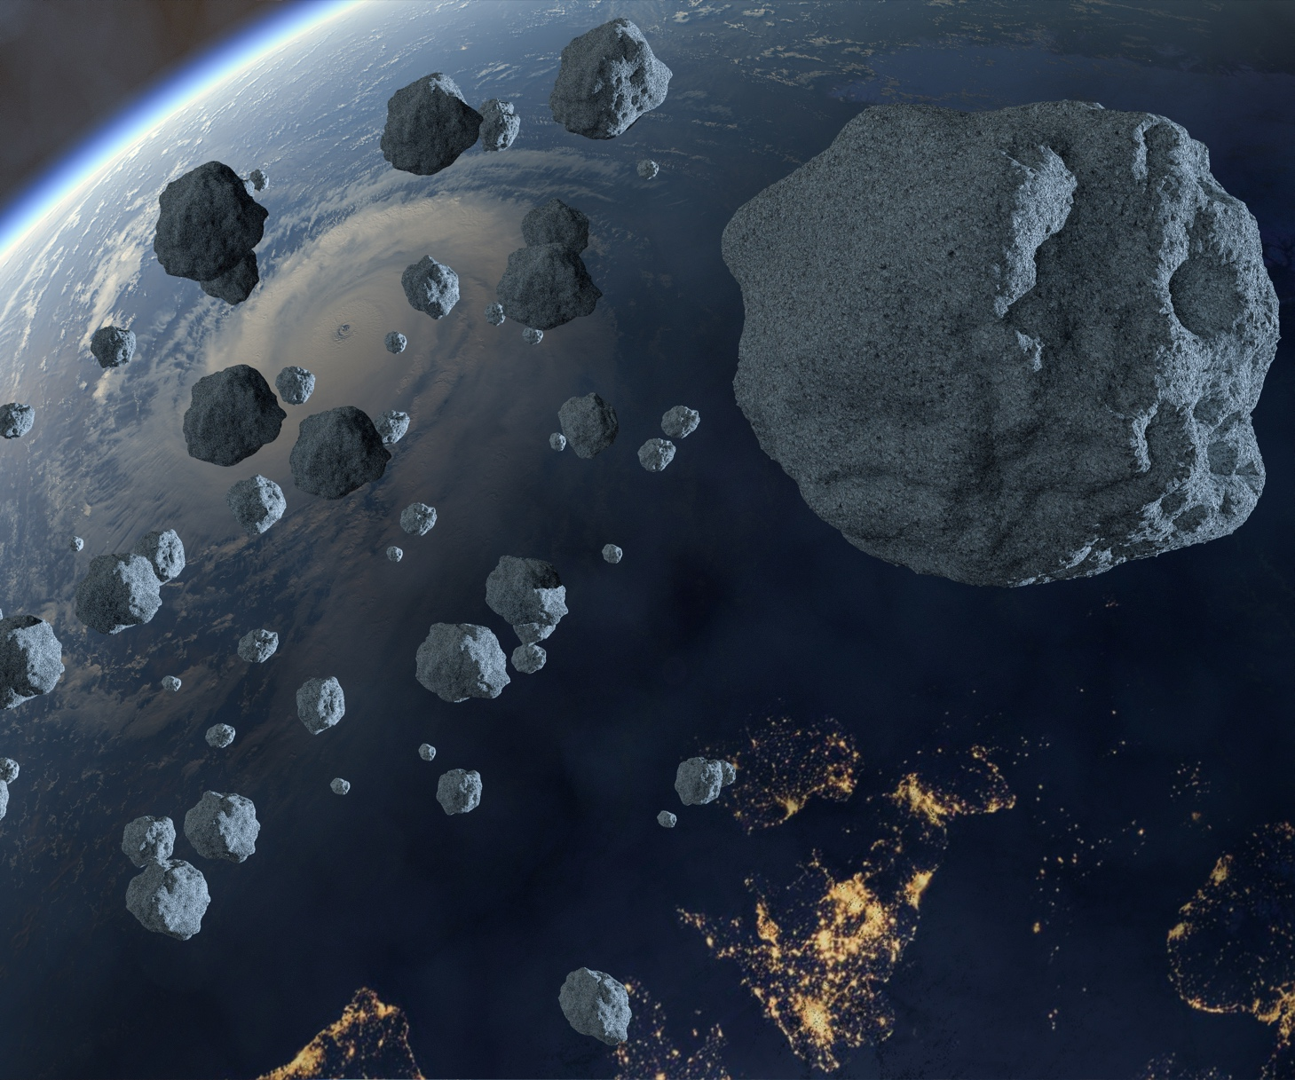
Section F – Near-Earth Object Careers
Name 3 things you found interesting or have questions about

Slide 8

Current Space Enterprise Responsibilities
On-Orbit
Satellite Programs
Developmental
Satellite Programs
Launch Vehicles
Ground Systems
SBIRS
Defense Support Program
AEHF and Milstar
Enhanced Polar System
WGS and DSCS
MUOS
GPS
SBSS
GSSAP
Defense Meteorological
Satellite Program
Classified programs
GPS III
Meteorological programs
Operationally Responsive Space
Overhead Persistent Infrared
Classified programs
NSSL
– Atlas V – Delta IV
New Entrant Launch Systems
– SpaceX Falcon
– ULA Vulcan
– Orbital ATK NG
Satellite Control Network
Spacelift Range System
Ground control systems
for virtually all programs
Enterprise ground system
Battlespace management
command and control
Many user
terminal programs

Slide 9

Aerospace Matrix Support
Electronics
and Sensors
Information Systems
and Cyber
Communication Technologies and Engineering
Vehicle
Systems
Systems
Engineering
Physical Sciences Laboratories
Microelectronics
Analog and digital electronics
Power systems
Parts, materials
and processes
Sensor engineering
and exploitation
Data analytics and Multi-INT fusion
Sensor prototype development
Optical sensors
Radar systems
Electronics survivability systems engineering
Computer technology
Data science
Software engineering
Software assurance
Software systems acquisition
Ground and flight systems
Cybersecurity
Architectures
Network systems
Spacecraft payloads
Digital signal processing
RF electronics
Antennas/ground systems
Optical communications
Wireless communications
Machine learning
for digital communi-cations systems
Spectrum management
GPS signals
and reception
Geolocation
Cryptography
Guidance, navigation
and control
Embedded systems
Flight mechanics
Fluid dynamics
Propulsion
Thermal control
Structures and mechanisms
Ordnance
Dynamic loads and environments
Vehicle engineering
Architecting
Modeling and
simulation
Mission performance
Concept design
Cost and schedule engineering
Systems engineering
assessment and
acquisition support
Program analytics and economic market analysis
Operability assessment
Reliability and
failure analysis
Systems integration
Facilities engineering
Exploitation of air and
space environments
Prototype development
Spectroscopy and
remote sensing
Atomic clocks and
precision timing
Laser applications
Microelectronics
evaluation
Space power
Contamination
Propulsion sciences
Advanced manufacturing
Materials processing

Slide 10
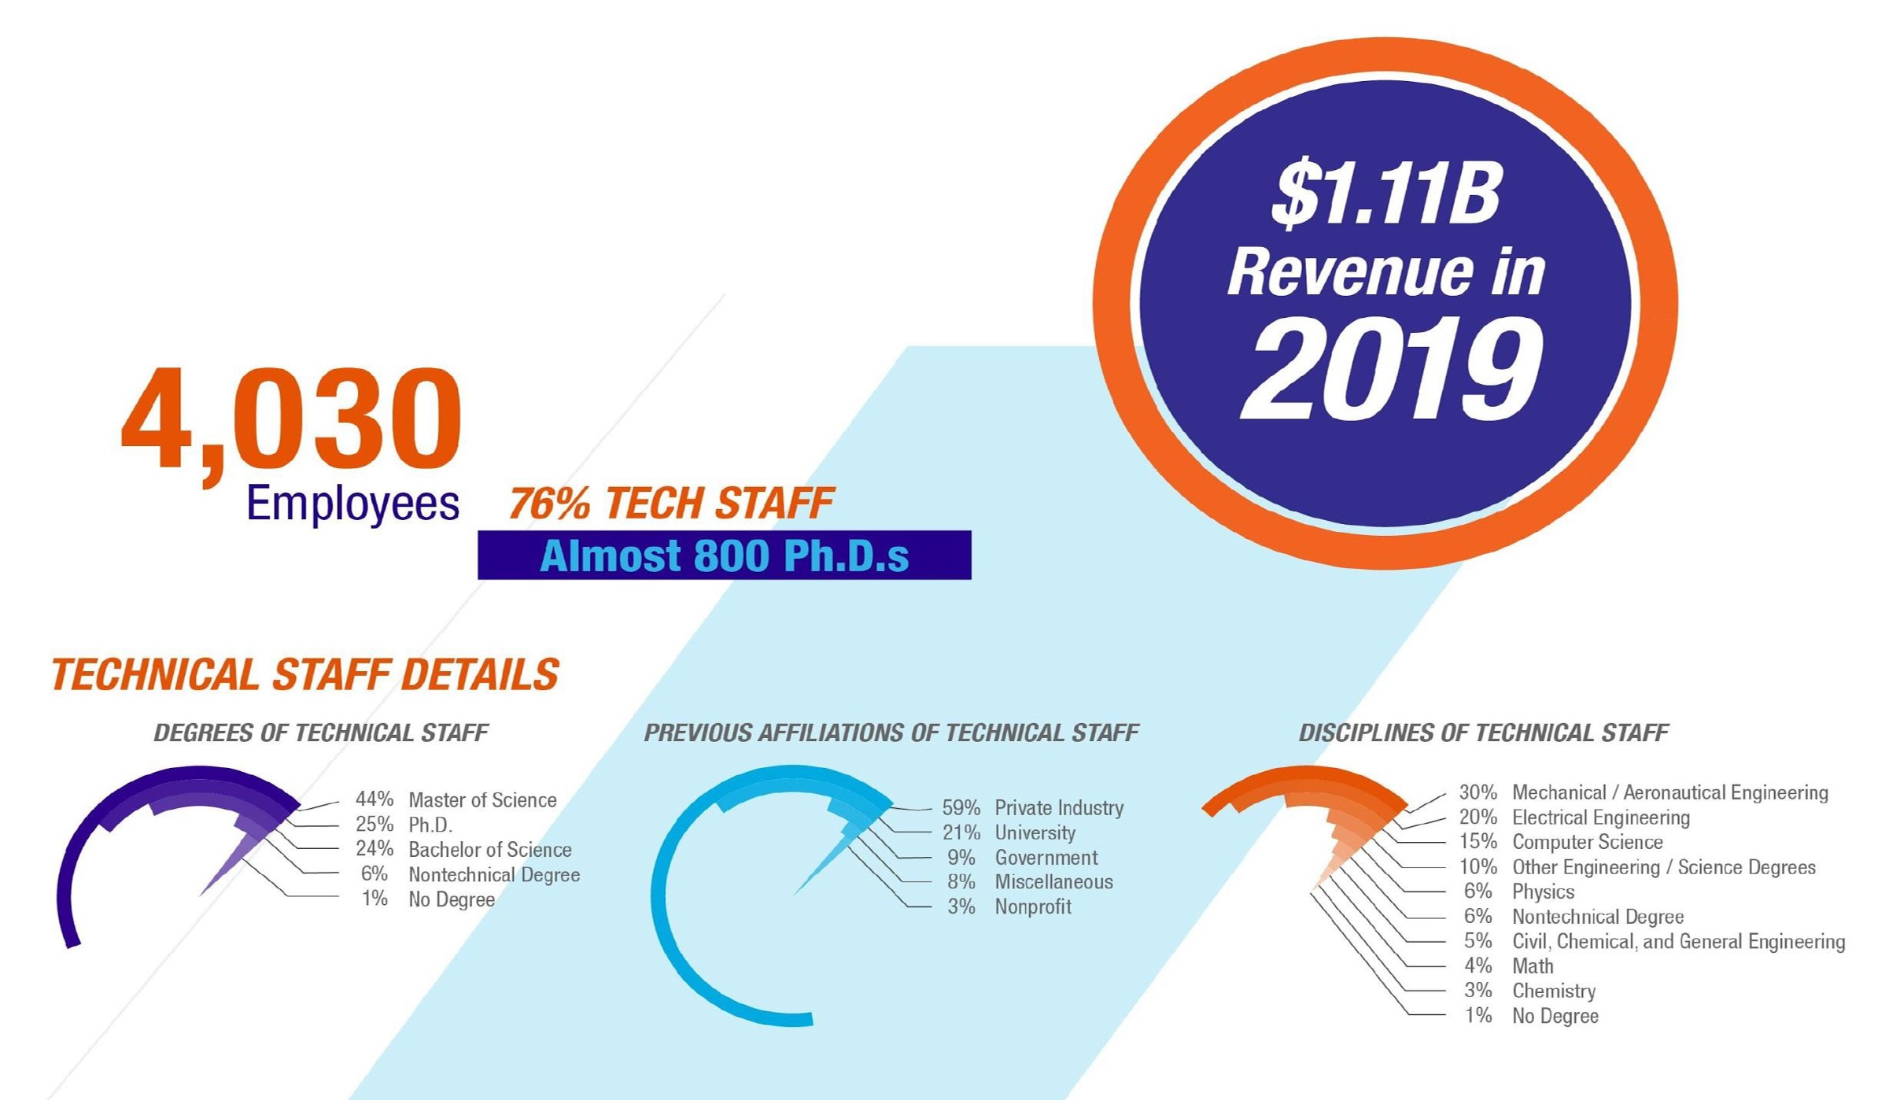
Aerospace by The Numbers

Slide 11
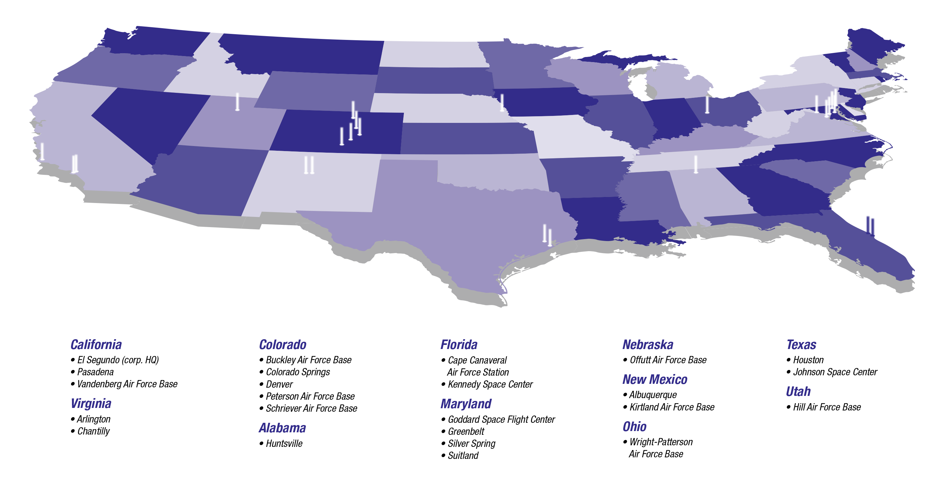
Nationwide Scope
CALIFORNIA
• El Segundo (corp. HQ)
• Pasadena
• Vandenberg
Air Force Base
VIRGINIA
• Arlington
• Chantilly
COLORADO
• Buckley Air Force Base
• Colorado Springs
• Denver
• Petersen Air Force Base
• Schriever Air Force Base
ALABAMA
• Huntsville
FLORIDA
• Cape Canaveral
Air Force Station
• Kennedy Space Center
MARYLAND
• Goddard Space
Flight Center
• Greenbelt
• Silver Spring
• Suitland
NEBRASKA
• Offutt Air Force Base
NEW MEXICO
• Albuquerque
• Kirtland Air
Force Base
OHIO
• Wright-Patterson
Air Force Base
TEXAS
• Houston
• Johnson Space Center
UTAH
• Hills Air Force Base

Slide 12
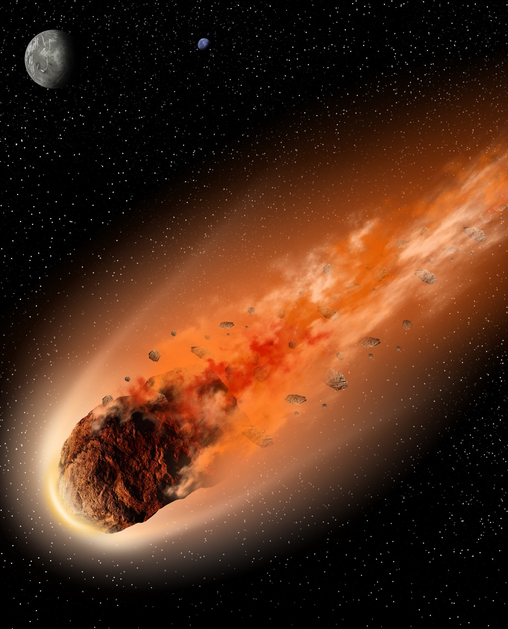
Section G – Fireballs
Circle which area your teacher is having you focus on from the list:
Date ranges
Impact size ranges in kt
Latitude and Longitude ranges
Energy ranges
Velocity ranges
Change the dates to be the most recent. Then zoom in and
take a screenshot of your observations of fireballs. Insert
your screenshot here.
What are two specific things you notice or observe about the
fireballs for your section? Explain in detail.
What do you think you could do if you could alter/change
and keep the objects from hitting Earth? What would you do/ change and why?

Slide 13
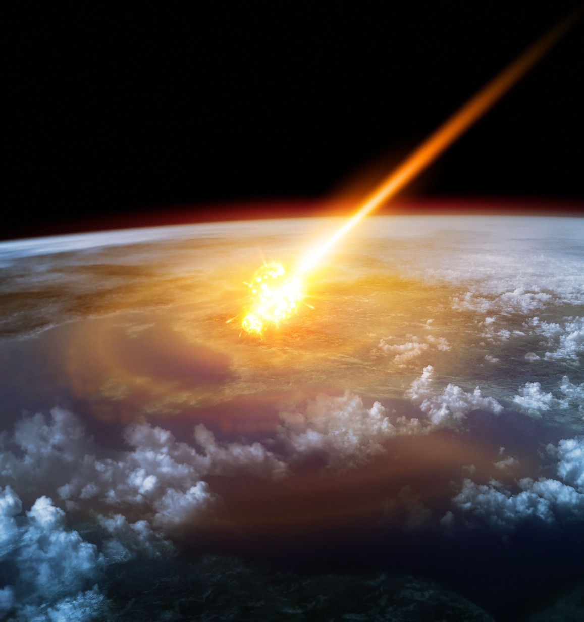
Section H – Defending Earth
What keywords/vocabulary do you think will help scientists and engineering investigate NEO and
keep Earth safe?
What if we could change whether a NEO becomes a fireball, what would you do to keep a NEO from hitting Earth? Tell your story in detail.

Slide 14
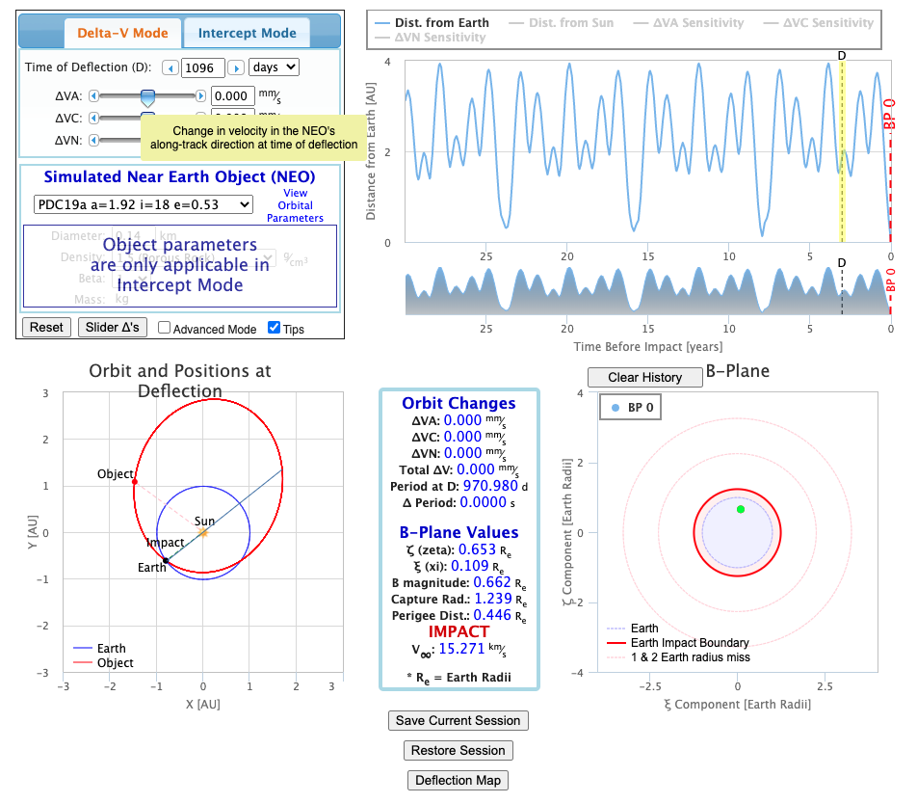
Section I – NEO Deflection App
Experiment with all the following options. Write
what happens when you change each of these:
  Delta-V Mode
  Intercept Mode
  Time of Deflection
  Simulated Near-Earth Objects
  Density (Intercept Mode)
  Beta (Intercept Mode)
  B-Plane

Slide 15
Thank you
ANY QUESTIONS?
You can find me at @username & user@mail.me

