Slide 1
Near-Earth Object Scientist Slides
Speaker’s Name and Organization – 20 Point Arial
October 2020

Slide 2
Instructions for Use
Using These Slides to Present to Students:
You will be meeting with students who have learned the basics of tardigrades
They are challenge with the following task:
Design an experiment to test the outer limits of tardigrades survival to understand space resiliency
They will be given canned data to interpret based on their assigned variable
Change slides to be about you! Keep it simple as the students will be lost in the details
Anywhere you see curly brackets { } replace the information with your own words
Replace images with images of your work (Reminders are in the speaker notes)

Slide 3

Hello!
I AM {insert Name and title}
I study {insert area of expertise}

Slide 4

My Research
{A picture is worth a thousand words. A complex idea can be conveyed with just a single still image. Use this area to write one sentence describing the image}

Slide 5
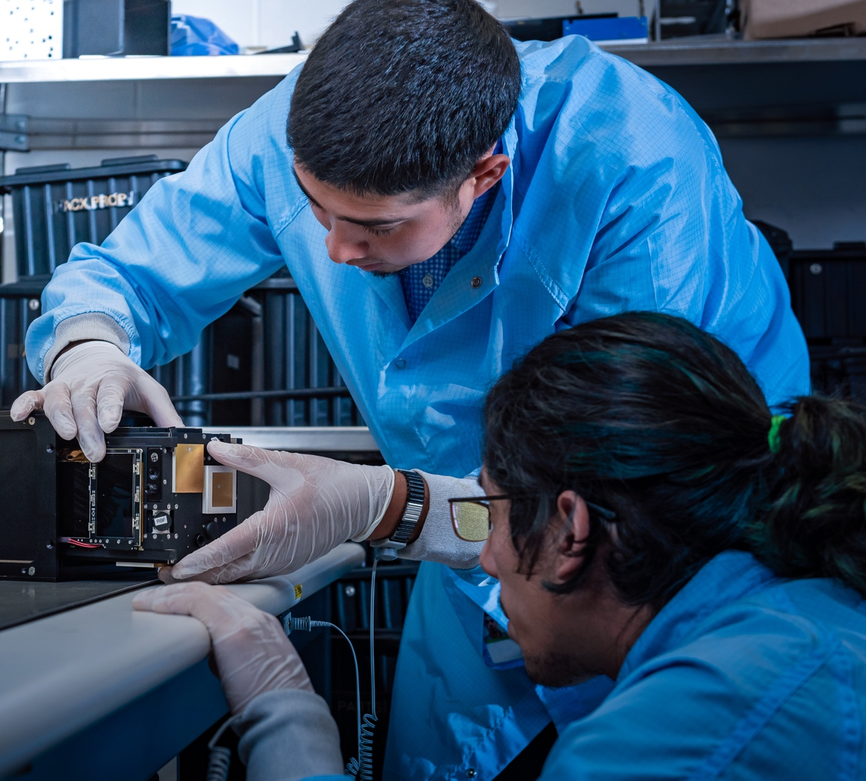
Near Earth Objects
{How do scientists work together to find NEOs? Include a brief summary about how collaboration is an important part of your work at The Aerospace Corporation}

Slide 6
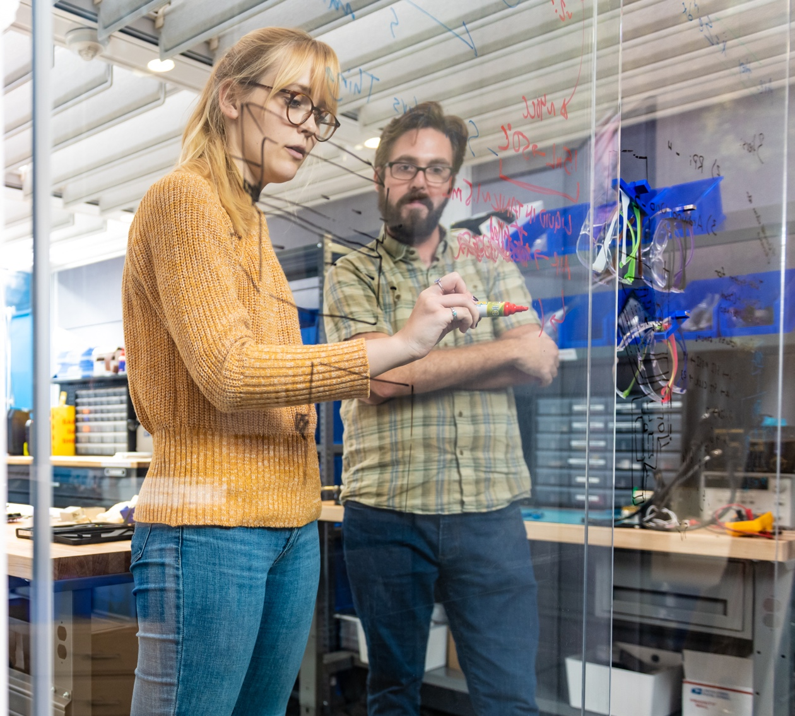
My Research Goals
{Use this area to write one sentence describing the long-term goal of your work.}

Slide 7
Thank you
ANY QUESTIONS?
You can find me at @username & user@mail.me

