Slide 1

Falling Stars Lesson

Slide 2
Section A - Thinking About The Sky
What do you think you see when you look up at the sky during the day?
What do you think you see when you look up at the sky at night?
Draw a picture of what you think the sky looks like at night.

Slide 3

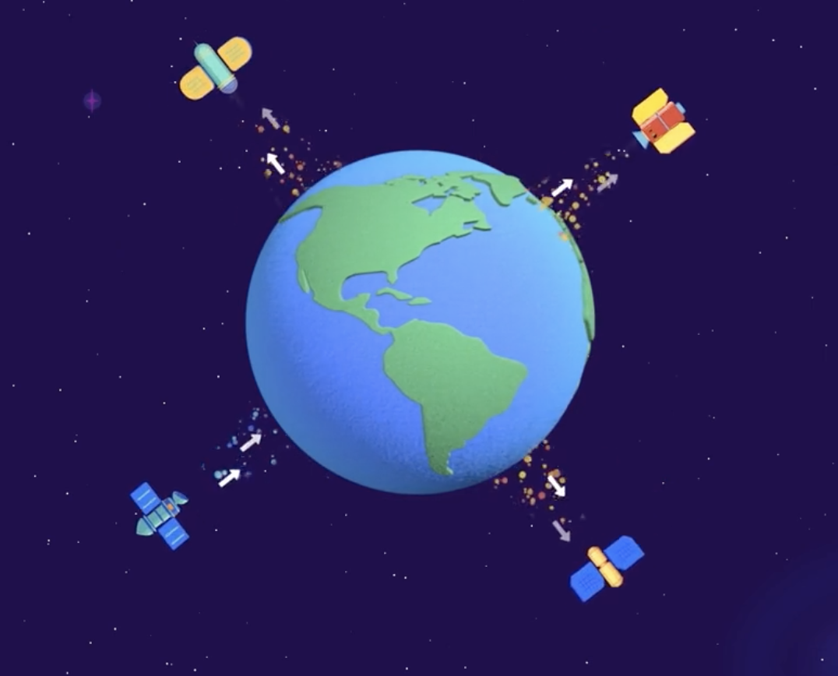
Section B - Thinking About Orbits
What do you think uses technology that is in the sky?
What do you think it means to orbit another object?
How many objects do you think are up in orbit around the Earth at the same time?

Slide 4
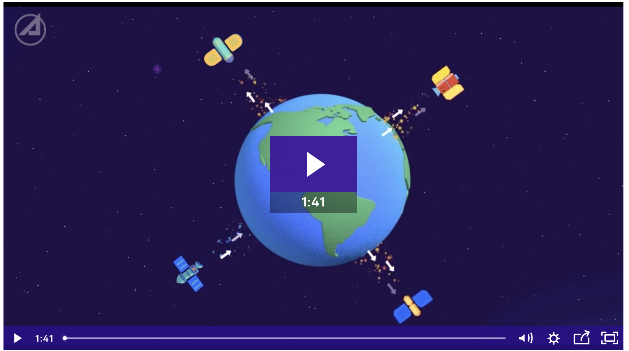
Section B - Thinking About Orbits
Let’s watch The Value of Space

Slide 5
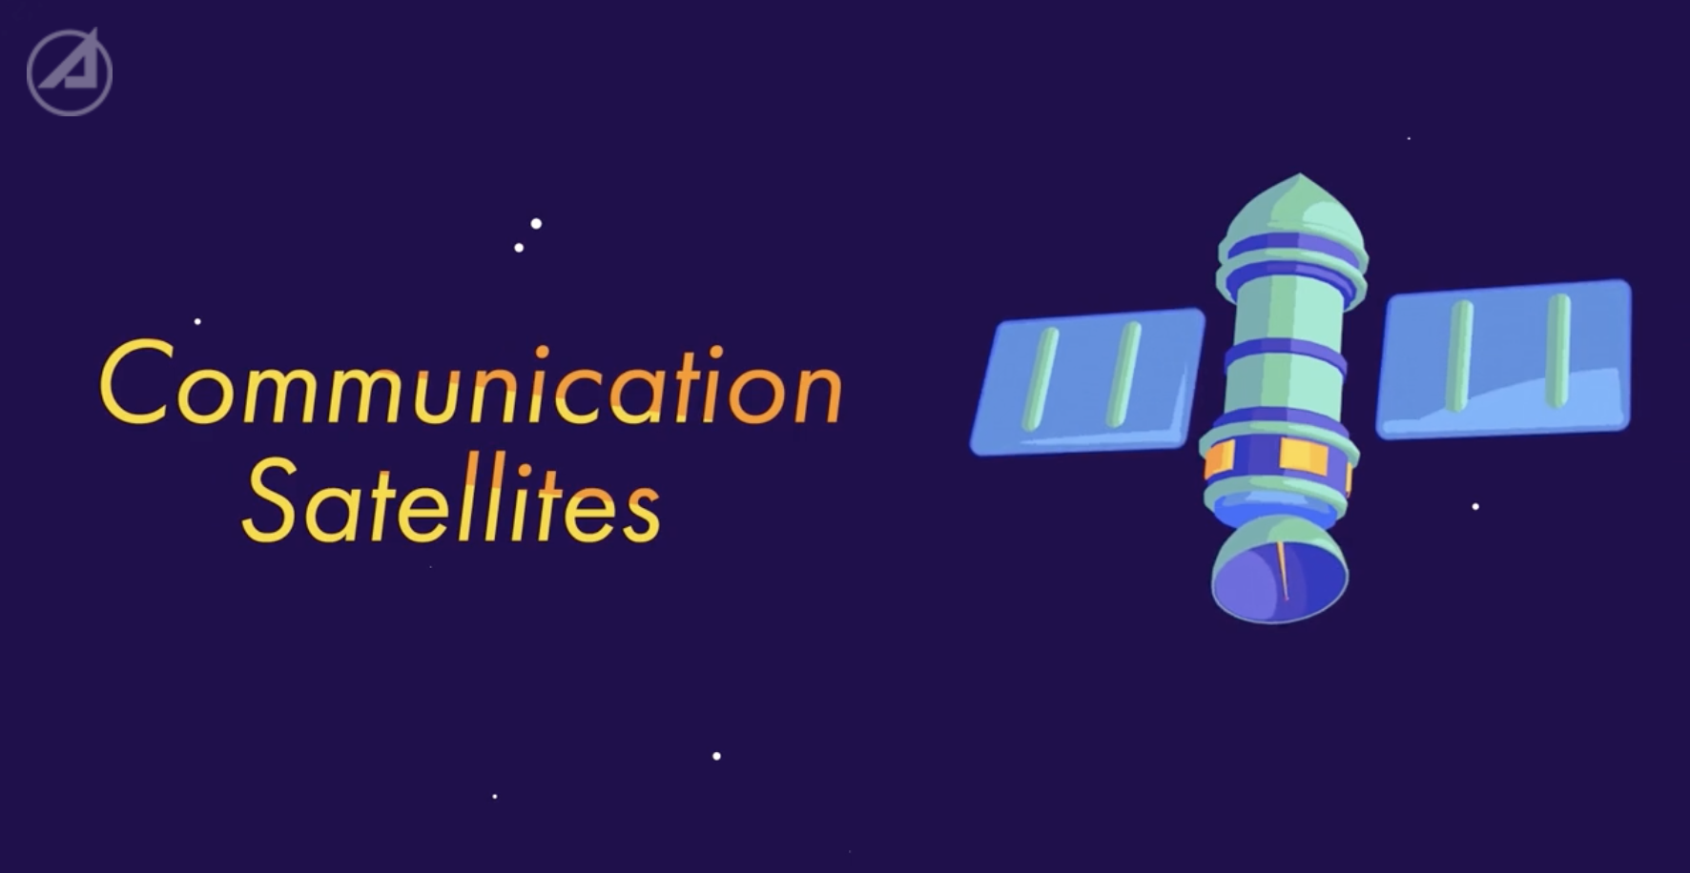
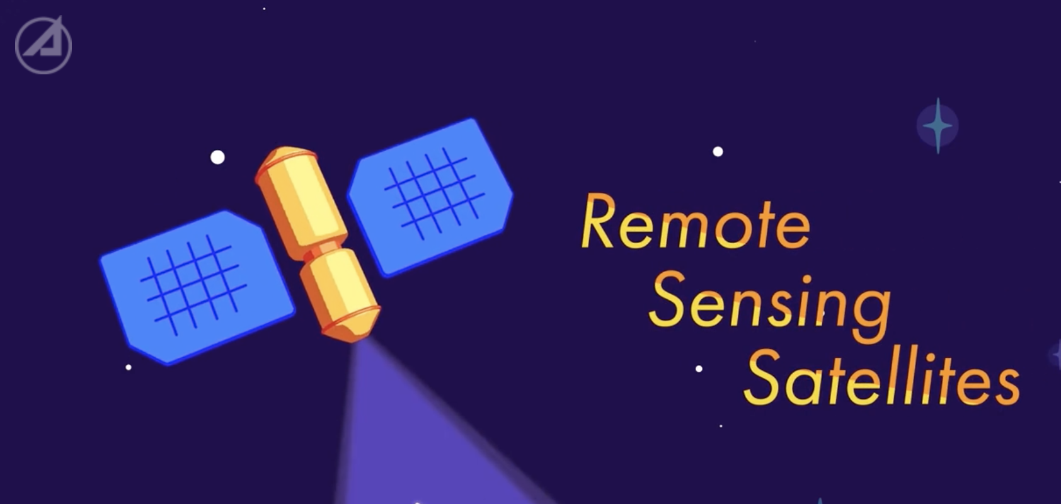
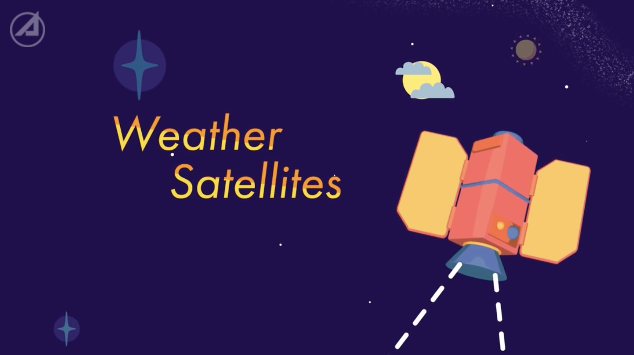
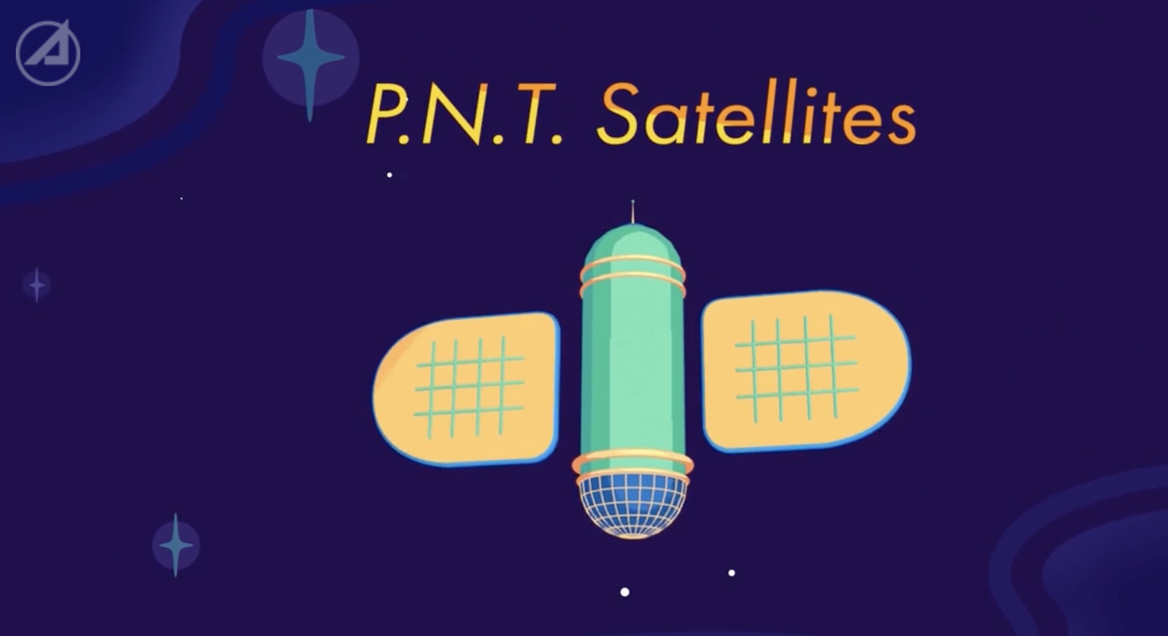
Section B - Thinking About Orbits
What do the first three satellites do?
What does the forth satellite do?

Slide 6
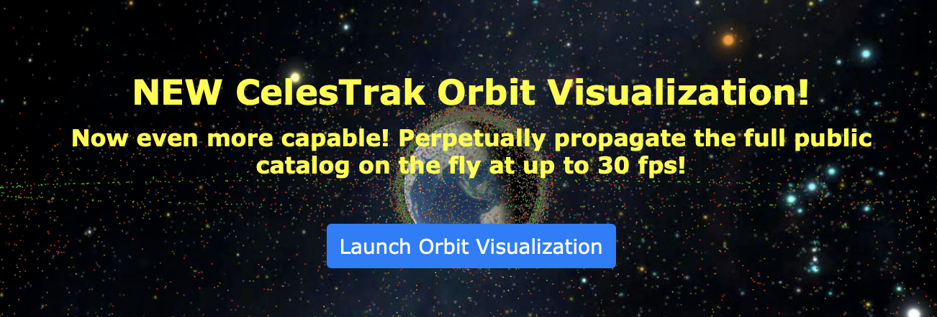
Section C - Satellites Everywhere
How much do you think you use outer space? Let’s talk about the things that use space technology.
Go to CelesTrak

Slide 7
Section C - Satellites Everywhere
What do you notice about the satellites?
How long do you think these satellites and objects have orbited Earth?
How small do you think the smallest satellite is?
Why do you think there are so many satellites?
What are the different colors of satellites (dots)?
Try to click on a satellite (dot), what happens when you click it and what do you notice about it?

Slide 8
Section C - Satellites Everywhere
The Life Cycle of a Satellite
Develop/Build (What are we making)
Scientist and engineers working together as a team
Launch (How will we get there)
Engineers mainly focus on getting off of Earth
On Orbit Ops (Why is this data important)
Scientists figure out what the data means and engineers make things happen
Decommissioning/Re-entry (Where will it go)
Mainly engineers, but scientists make tools and models to predict re-entry and where it will come back into Earth’s atmosphere

Slide 9
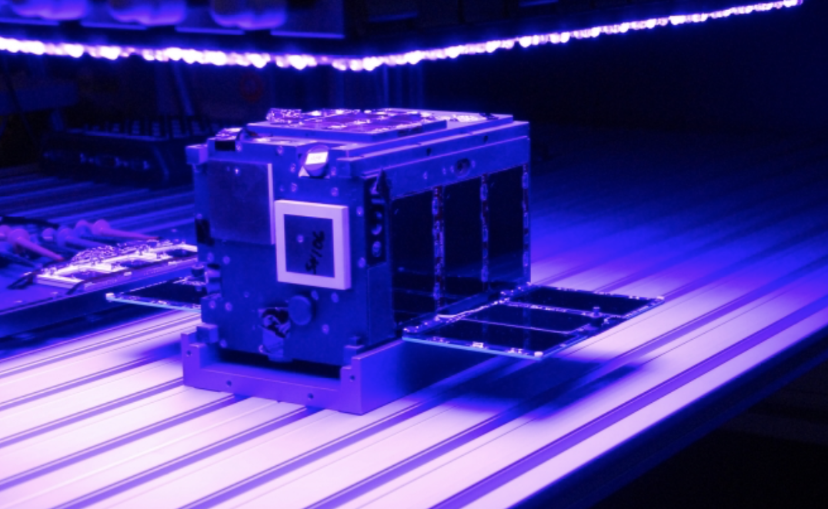
Section D - The Falling Stars
The Falling Star probe is released from the Aero-Cube 10, which is a CubeSat
***Which part of the Life Cycle of a Satellite is this?

Slide 10
Section D - The Falling Stars
What did you learn today about orbits and satellites?
What is different and what is the same from your original answers on your student handout?

Slide 11
Section E - Aerospace is a Team
What are your favorite teams whether it’s from sports, personal experiences or anything that represents a team?
Link to “Going into Action the AeroCube-10”
What is a time that you collaborated or worked with someone one? What was it like?
What is a way to build and solve problems together similar to career video?

Slide 12
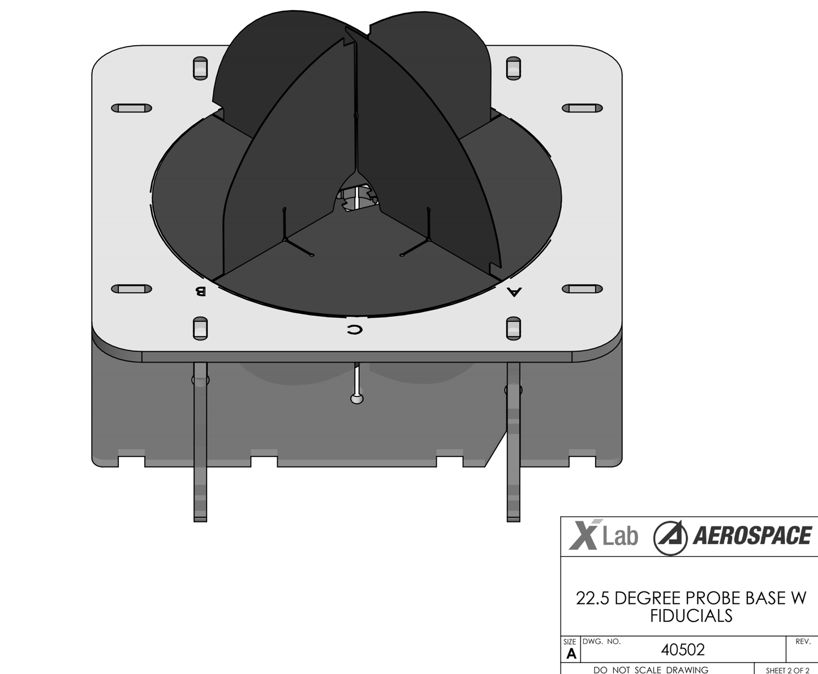
Section F - Making the Falling Star
Cut out the Probe Template
***Which part of the Life Cycle of a Satellite is this?

Slide 13
Section F - Making the Falling Star
If you try dropping your Falling Star Probe, what do you notice?
***Which part of the Life Cycle of a Satellite is this?
What was similar and what was different between the Probes?
Why do you think so?
What did you observe about your probe compared to your classmates?
***Which part of the Life Cycle of a Satellite is this?

Slide 14
Section G - Connection the Life Cycle of a Falling Star
If the ground was like Earth how are your probes are “falling” towards Earth?

Slide 15
Section G - Falling Stars Team
Did you do this all together?
Did you need someone to talk to?
Did someone in the class have an idea that you tried?
What do you think could be things that change how a Falling Star returns and re-enters Earth’s atmosphere? (Orbital environmental atmospheric features)

Slide 16
Section G - Falling Stars Team
What did you learn about working together?
What was it like working on your own?
How can this help you work on creating a new design?
Which part of the Life Cycle of a Satellite do you like best so far and why?

Slide 17
Section G - Satellites Everywhere
The Life Cycle of a Satellite
Develop/Build (What are we making)
Scientist and engineers working together as a team
Launch (How will we get there)
Engineers mainly focus on getting off of Earth
On Orbit Ops (Why is this data important)
Scientists figure out what the data means and engineers make things happen
Decommissioning/Re-entry (Where will it go)
Mainly engineers, but scientists make tools and models to predict re-entry and where it will come back into Earth’s atmosphere

Slide 18
Section H - Falling Stars Engineered
How can you make it fall slowly?
How can you control how it falls?

Slide 19
Section H - Falling Stars Experiment
Teams will choose one goals:
Goal #1 Falling Star falls the slowest speed (the greatest amount of drag, the longest time in seconds in air)
Goal #2 Falling Star falls (descent to re-entry) to a specific target location. Try to hit the “X” on the classroom floor.
Each team will have:
Lead Scientist: records all of the groups’ ideas and presents the ideas to the class
Lead Engineer: collects the materials for the experiments based on the team Goal.

Slide 20
Section I - Falling Stars Experiments
Graphing as a class:
Goal 1: Number of Strings versus Drop Time, Type of Material versus Drop Time, Number of Holes versus Drop Time
Goal 2: Number of Strings versus Drop Time, Type of Material versus Drop Time, Number of Holes versus Drop Time

Slide 21
Section I - Falling Stars Experiments
Who dropped the fastest?
Who dropped the slowest?
Who got closest to their target for greatest accuracy?
Who do you think had more drag and why?
Which group had the slowest speed?

Slide 22
Section I - Falling Stars Experiments
What changed the probes falling?
What new ideas do you have about satellites?

Slide 23
Section I - Falling Stars Experiments
How can this experiment be similar to the real design and partnership of scientists and engineers working together like they do Aerospace Corp?
Is there any evidence for your ideas working?
What were the ideas that gave us the best results?

Slide 24
Section I - Falling Stars Experiments
Write reflection on how do you use space on a daily basis?
What is the life cycle of a falling star?
How do teams work together to put objects into space?

Slide 25
Section I - Falling Stars Experiments
In your own words describe what you did for each part of the Life Cycle of a Satellite:
Develop/Build
Launch
On Orbit Ops
Decommissioning/Re-entry

Slide 26
Section I - Falling Stars Experiments
The Life Cycle of a Satellite
Develop/Build (What are we making)
Scientist and engineers working together as a team
Launch (How will we get there)
Engineers mainly focus on getting off of Earth
On Orbit Ops (Why is this data important)
Scientists figure out what the data means and engineers make things happen
Decommissioning/Re-entry (Where will it go)
Mainly engineers, but scientists make tools and models to predict re-entry and where it will come back into Earth’s atmosphere

Slide 27
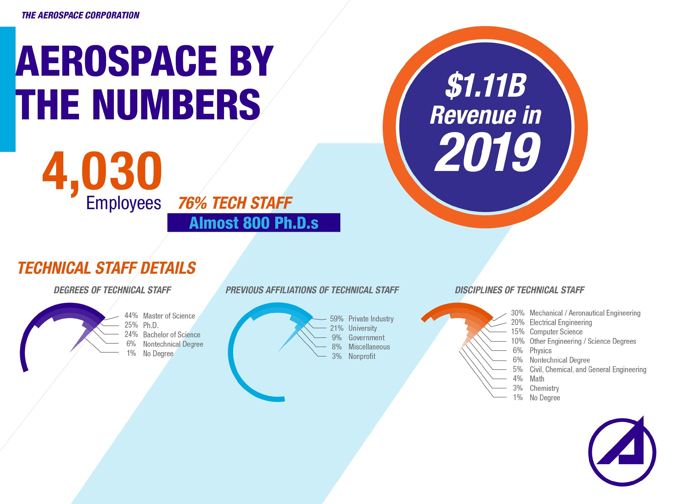
27
Notes:
AEROSPACE BY THE NUMBERS
4,030 employees, 76% tech staff
Almost 800 Ph.D.s
Revenue:
$1.11B Revenue FY2019
Technical Degrees
Master of Science 44%
Ph.D. 25%
Bachelor of Science 24%
Non-Technical Degree 6%
No Degree 1%
Previous Affiliation
Private Industry 59%
University Staff/Students 21%
Government 9%
Miscellaneous 8%
Non-Profit 3%

